Slide 1
UNIT 6 Live Session
Contrasts
Multiple Comparison

Slide 2
Overview
ANOVA provides an F-test for equality of several means.
The main weaknesses are
It doesn’t tell us which means are different
It doesn’t account for any structure in the groups
The downside to this more refined analysis is that we need to control for the number of comparisons we end up making.
(Example: Is the average treatment effect across 3 levels of treatments different from the placebo?)

Slide 3
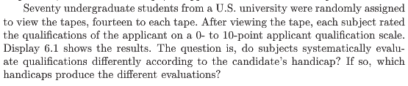
Example:Handicap & Capability Study¹
Goal: How do physical handicaps affect perception of employment qualification?
The researchers prepared 5 video taped job interviews with same actors
The tapes differed only in the handicap of the applicant:
No handicap (This is the control group)
One leg amputated
Crutches
Hearing Impaired
Wheelchair
14 students were randomly assigned to each tape to rate applicants: 0-10 pts (70 students total.)
1. (Cesare, Tannenbaum, and Dalessio “Interviewers’ decisions related to applicant handicap type and rater empathy” (1990) Human
Performance)

Slide 4
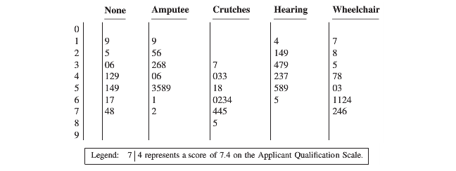
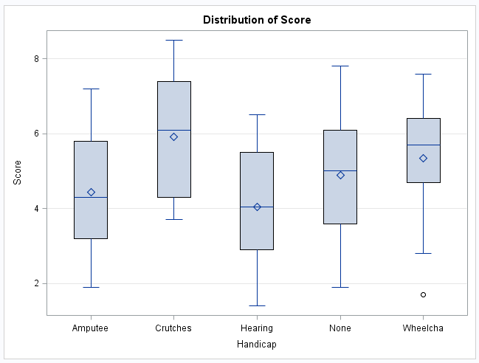
Example: Handicap & Capability Study
Do subjects systematically evaluate qualifications differently according to handicap?
If so, which handicaps are evaluated differently?

Slide 5

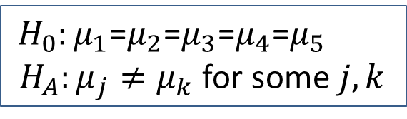




Is There Any Difference at All?
We should begin any analysis involving several groups by using the ANOVA framework
If there isn’t any (statistically) significant difference in the population means, then there is no reason to address more refined questions
The tapes differed only in the handicap of the applicant:
No handicap (This is the control group.)
One leg amputated
Crutches
Hearing Impaired
Wheelchair
$${(μ}_{None})$$
$${(μ}_{Amp})$$
$${(μ}_{Crutch})$$
$${(μ}_{Hear})$$
$${(μ}_{Wheel})$$
$H_{0}:μ_{1}$=$μ_{2}$=$μ_{3}$=$μ_{4}$=$μ_{5}$
${ H}_{A}:μ_{j}≠μ_{k}$ for some $j,k$

Slide 6
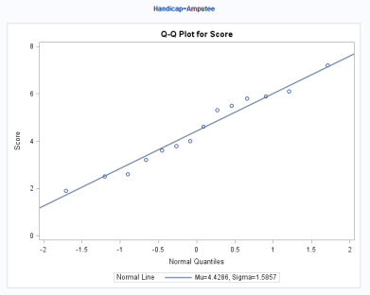
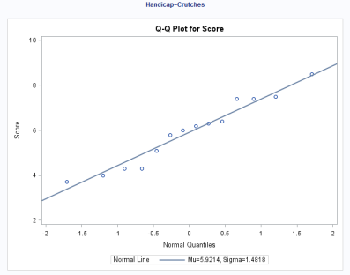
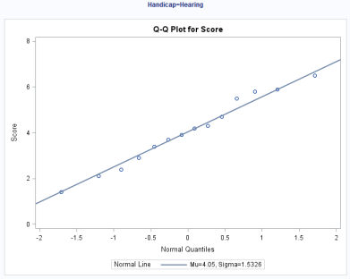
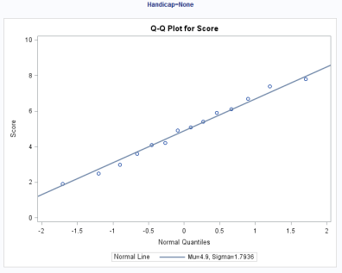
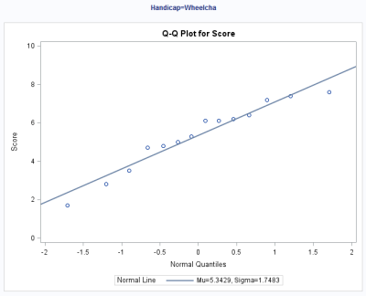
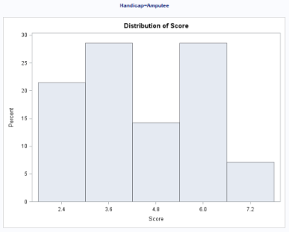
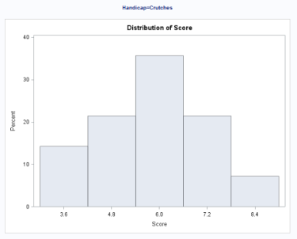
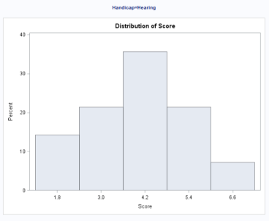
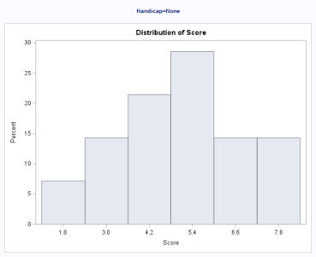
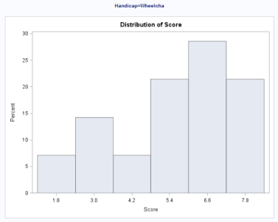
Handicap & Capability Study: Normality Assumption
There is NO visual evidence to suggest that the data are not normally distributed. We will proceed with the assumption of normally distributed groups Really?.

Slide 7
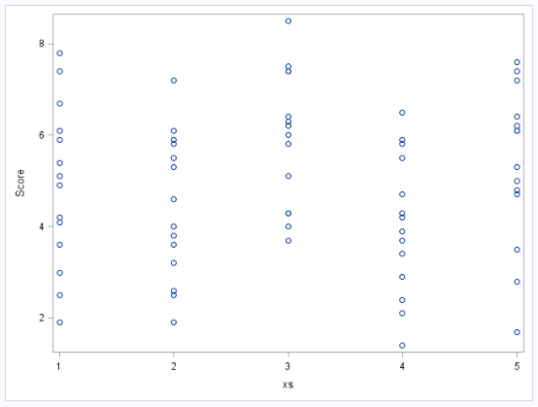
Handicap & Capability Study: Equal Variances Assumption
There is NO evidence to suggest variances are unequal.

Slide 8
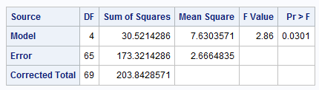
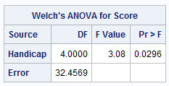


Handicap & Capability Study: ANOVA results
$H_{0}:μ_{1}$=$μ_{2}$=$μ_{3}$=$μ_{4}$=$μ_{5}$ ($μ$)
$H_{A}:μ_{j}≠μ_{k}$ for some $j,k$
There is evidence to support the claim that at least two population means are different from each other (p-value of 0.0301 from a 1-way ANOVA).
Notice that since there is virtually no evidence of a difference in standard deviations, Welch’s test is almost identical to the pure F ANOVA.

Slide 9
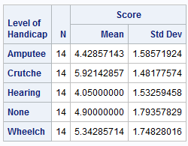

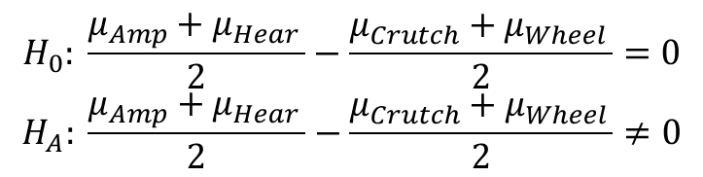
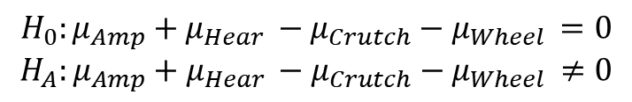
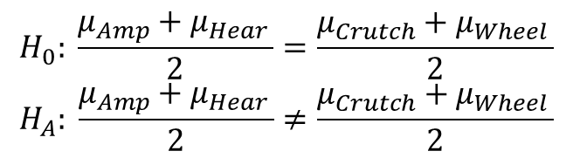
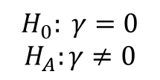

Handicap & Capability Study: More Specific Questions
$$H_{0}: \frac{μ_{Amp}+μ_{Hear }}{2}=\frac{μ_{Crutch}+μ_{Wheel }}{2}$$
$$H_{A}: \frac{μ_{Amp}+μ_{Hear }}{2}≠\frac{μ_{Crutch}+μ_{Wheel }}{2}$$
$$↕$$
$$H_{0}: \frac{μ_{Amp}+μ_{Hear }}{2}−\frac{μ_{Crutch}+μ_{Wheel }}{2}=0$$
$$H_{A}: \frac{μ_{Amp}+μ_{Hear }}{2}−\frac{μ_{Crutch}+μ_{Wheel }}{2}≠0$$
(contrast)
$γ=0.5μ_{amp }−0.5μ_{Crutch }$ $+0.5μ_{Hear }$ $+0μ_{None }−0.5μ_{Wheel}$
$$H_{0}:{μ_{Amp}+μ_{Hear }−μ}_{Crutch}−μ_{Wheel }=0$$
$$H_{A}:{μ_{Amp}+μ_{Hear }−μ}_{Crutch}−μ_{Wheel }≠0$$
$${ H}_{0}: γ=0$$
$$H_{A}:γ≠0$$
$$↕$$
(contrast)
$γ=1μ_{amp }−1μ_{Crutch }$ $+1μ_{Hear }$ $+0μ_{None }−1μ_{Wheel}$

Slide 10



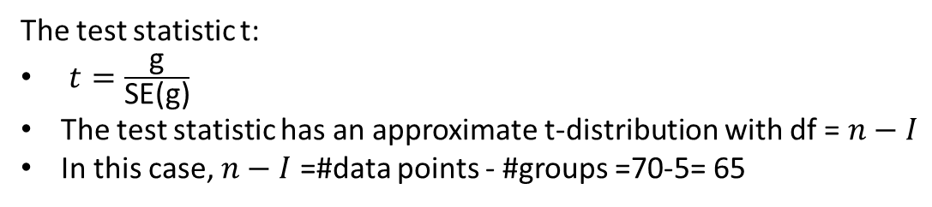
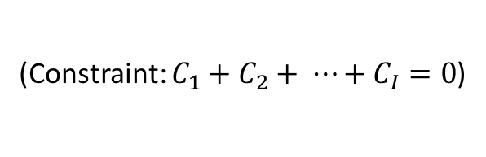
Linear Combinations & Contrasts
(Constraint: $C_{1}+C_{2}+ ⋯+C_{I}=0$)
s_{p} = sqrt(Mean Square Error (Within ) )
(this requires independence)
Example: $γ=1μ_{Amp}−1μ_{Crutch}$ $+1μ_{Hear}$ $+0μ_{None}−1μ_{Wheel}$
The test statistic t:
$t=\frac{\text{g}}{\text{SE}\text{(}\text{g}\text{)}}$
The test statistic has an approximate t-distribution with df =$n−I$
In this case, $n−I$ =#data points - #groups =70-5= 65

Slide 11
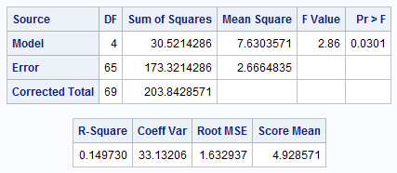
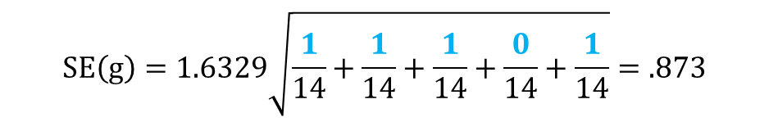
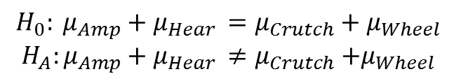
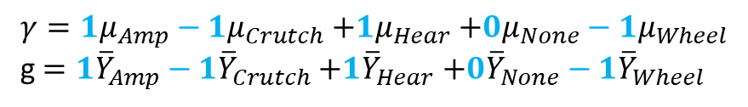
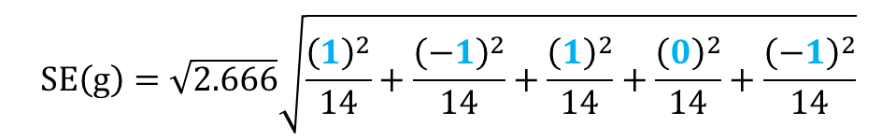
Handicap & Capability Study: A Contrast Amp and Hear vs. Crutch and Wheel Groups
Calculate mean difference and standard error
$$H_{0}: μ_{Amp}+μ_{Hear }=μ_{Crutch}+μ_{Wheel }$$
$$H_{A}:μ_{Amp}+μ_{Hear }≠μ_{Crutch}{+μ}_{Wheel }$$
$γ=1μ_{Amp}−1μ_{Crutch}$ $+1μ_{Hear}$ $+0μ_{None}−1μ_{Wheel}$
g$=1{\overline{Y}}_{Amp}−1{\overline{Y}}_{Crutch}$ $+1{\overline{Y}}_{Hear}$ $+0{\overline{Y}}_{None}−1{\overline{Y}}_{Wheel}$
$g=\left(1\right)4.4−\left(1\right)5.9$ + ($1$)4.1 + (0)4.9 – ($1$)5.3 = - 2.8
$$SE\left(g\right)=\sqrt{2.666}\sqrt{\frac{{\left(1\right)}^{2}}{14}+\frac{{\left(−1\right)}^{2}}{14}+\frac{{\left(1\right)}^{2}}{14}+\frac{{\left(0\right)}^{2}}{14}+\frac{{\left(−1\right)}^{2}}{14}}$$
$$SE\left(g\right)=1.6329\sqrt{\frac{1}{14}+\frac{1}{14}+\frac{1}{14}+\frac{0}{14}+\frac{1}{14}}=.873$$

Slide 12
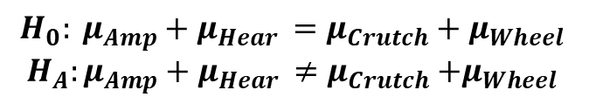
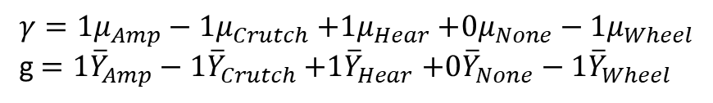


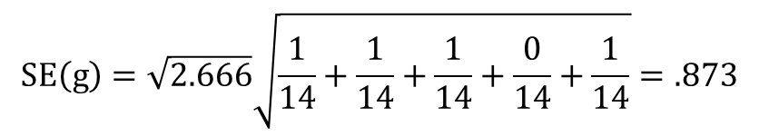

Handicap & Capability Study: Confidence Intervals for Contrast $γ$
$$H_{0}: μ_{Amp}+μ_{Hear }=μ_{Crutch}+μ_{Wheel }$$
$$H_{A}:μ_{Amp}+μ_{Hear }≠μ_{Crutch}{+μ}_{Wheel }$$
$γ=1μ_{Amp}−1μ_{Crutch}$ $+1μ_{Hear}$ $+0μ_{None}−1μ_{Wheel}$
g$=1{\overline{Y}}_{Amp}−1{\overline{Y}}_{Crutch}$ $+1{\overline{Y}}_{Hear}$ $+0{\overline{Y}}_{None}−1{\overline{Y}}_{Wheel}$
$g=\left(1\right)4.4−\left(1\right)5.9$ + (1)4.1 + (0)4.9 – (1)5.3 = - 2.8
$$SE\left(g\right)=\sqrt{2.666}\sqrt{\frac{1}{14}+\frac{1}{14}+\frac{1}{14}+\frac{0}{14}+\frac{1}{14}}=.873$$
There is evidence that the sum of points assigned to Amp & Hear handicaps is smaller than the sum of points assigned to Crutch & Wheel handicaps at level alpha equal to 0.05 because the CI does not contain 0.
CI: Point estimate ± multiplier* standard error
95% t-tools CI for $γ$: $−2.78577 ±(1.9971)(0.87286)$
95% t-tools CI for $γ$: $−2.78577 ±1.74319$
95% t-tools CI for $γ$: (-4.529, -1.043)

Slide 13
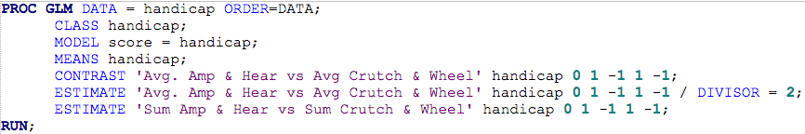

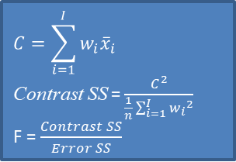
Handicap & Capability Study: In SAS
Contrasts in order of data entry rather than alphabetical
Handy when dividing weights by same number
$γ=1μ_{Amp}−1μ_{Crutch}$ $+1μ_{Hear}$ $+0μ_{None}−1μ_{Wheel}$
$γ=0.5μ_{Amp}−0.5μ_{Crutch}$ $+0.5μ_{Hear}$ $+0μ_{None}−0.5μ_{Wheel}$
g
SE(g)
g/SE(g)
$$C=\sum_{i=1}^{I}{w_{i}{\overline{x}}_{i}}$$
Contrast SS = $\frac{C^{2}}{\frac{1}{n}\sum_{i=1}^{I}{{w_{i}}^{2}}}$
F = $\frac{Contrast SS}{Error SS}$
Three different ways (contrast, estimate, estimate with divisor =2) to test for the same idea. (There are many more than three!)

Slide 14
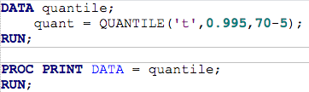

Handicap & Capability Study: Confidence Intervals From Contrasts
-1.39±2.65*0.436 => -1.39±1.155 => (-2.55, -0.23)
Since the Pr > |t| and the confidence interval does not contain zero There is evidence that the average points assigned to Amp & Hear handicaps is smaller than the average points assigned to Crutch & Wheel handicaps

Slide 15
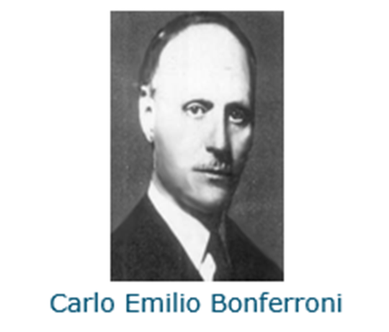
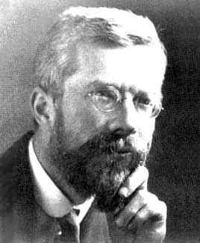
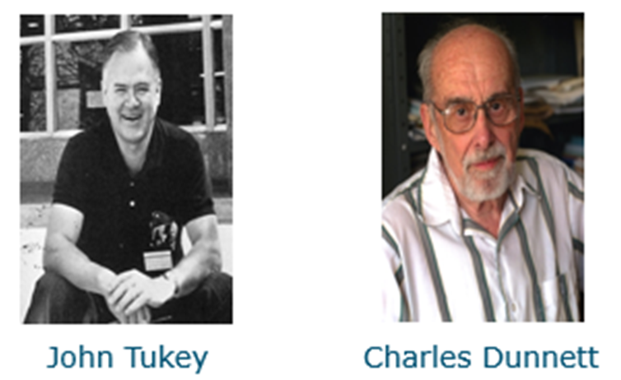
Multiple Comparison Procedures
Ronald Fisher (1935 LSD(t) Procedure))
If considering multiple comparisons good idea to make adjustments to test statistics and critical probabilities depending on adjustment method.

Slide 16
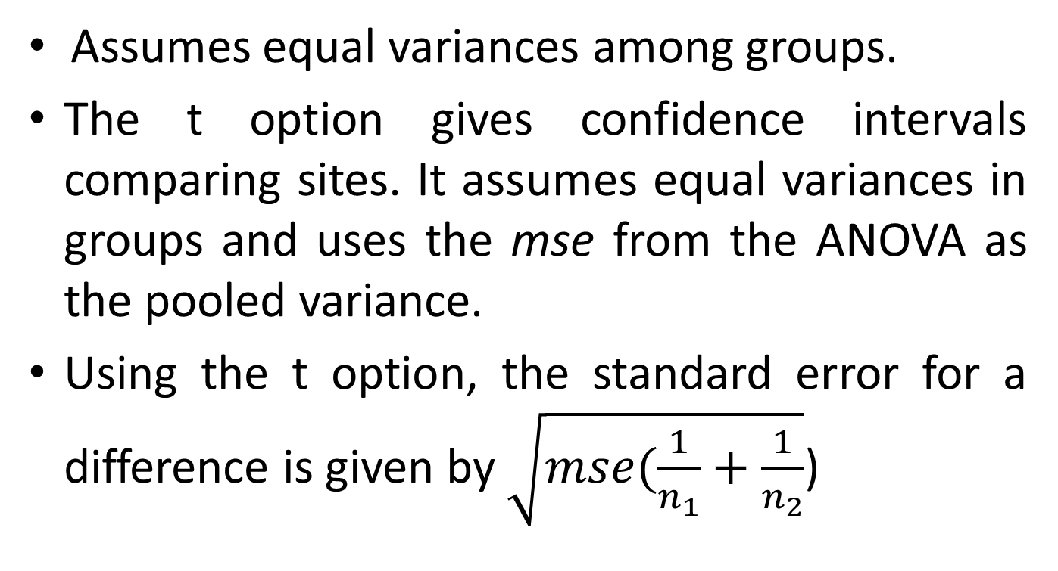
T or (Least Significant Difference (LSD)) Approach to Making Multiple Comparisons
Assumes equal variances among groups.
The t option gives confidence intervals comparing sites. It assumes equal variances in groups and uses the mse from the ANOVA as the pooled variance.
Using the t option, the standard error for a difference is given by $\sqrt{mse(\frac{1}{n_{1}}+\frac{1}{n_{2}}}$)

Slide 17
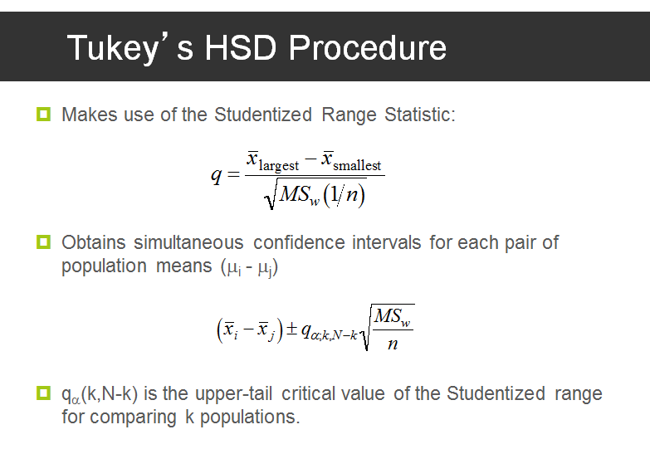
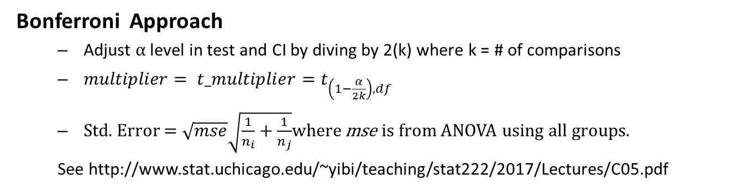
Multiple Comparison Bonferroni and Tukey's Method
Bonferroni Approach – similar to LSD method except t statistic is adjusted.
Bonferroni Approach
Adjust $α$ level in test and CI by diving by 2(k) where k = # of comparisons
$multiplier= t_multiplier=t_{\left(1−\frac{α}{2k}\right),df}$
Std. Error = $\sqrt{mse}\sqrt{\frac{1}{n_{i}}+\frac{1}{n_{j}}}$where mse is from ANOVA using all groups.
See http://www.stat.uchicago.edu/~yibi/teaching/stat222/2017/Lectures/C05.pdf
MSW = MSE
Assumes normal distributions, equal spreads, independence (same as typical t-tests), and equal
group sample sizes.

Slide 18
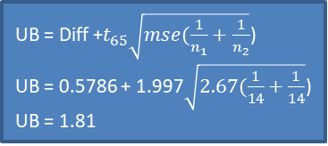
Multiple Comparisons t (LSD) & Bonferroni Methods in SAS
proc glm data = handicap order=data; class handicap; model score = handicap; means handicap/t bon tukey dunnett ('None') cldiff; run;
UB = Diff +$t_{65}\sqrt{mse(\frac{1}{n_{1}}+\frac{1}{n_{2}}}$)
UB = 0.5786 + 1.997$\sqrt{2.67(\frac{1}{14}+\frac{1}{14}}$)
UB = 1.81
α= 0.05/20
t_{65,0.0025}= 2.91

Slide 19
Multiple Comparisons Tukey and Dunnet t Method in SAS
Tukey Method
proc glm data = handicap order=data; class handicap; model score = handicap; means handicap/t bon tukey dunnett ('None') cldiff; run;
Dunnett Method

Slide 20
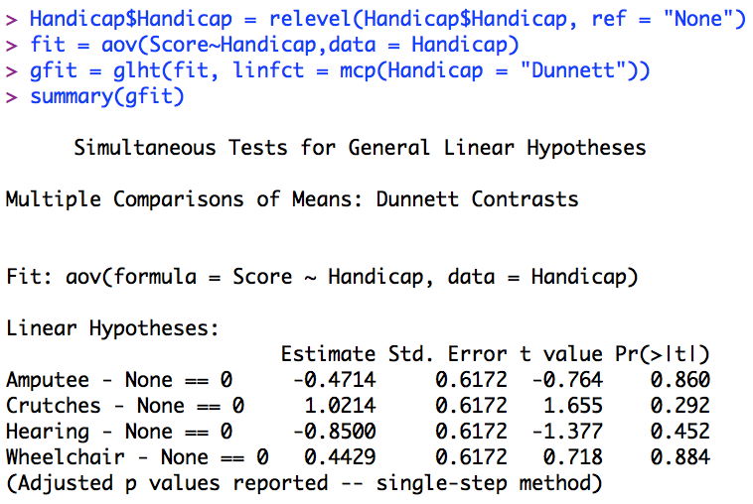
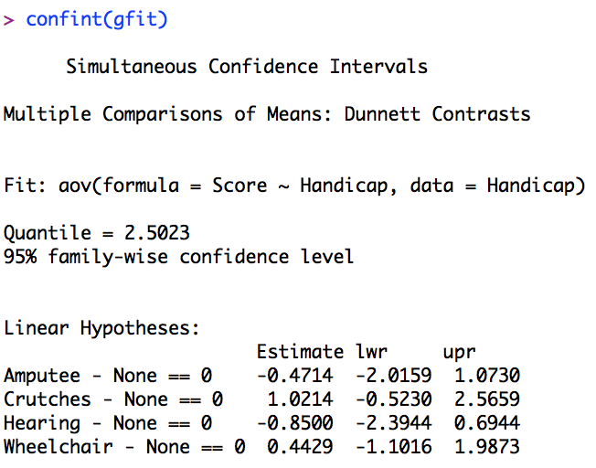
R Code for Handicap Example Question 4
Note: Must Load multcomp package

Slide 21
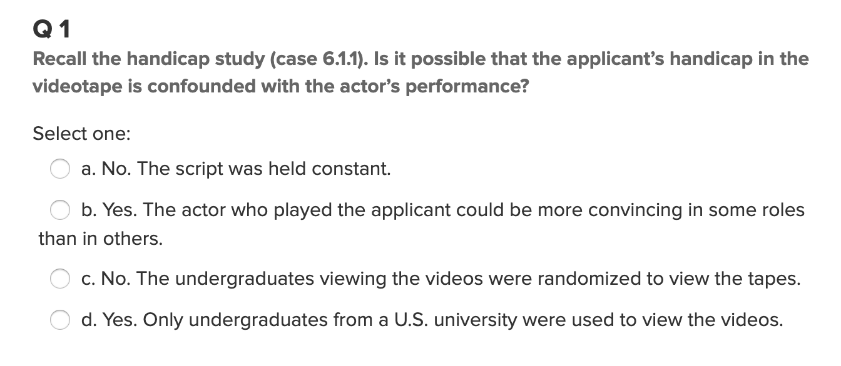
Quick Quiz Question 1 (<15 min)

Slide 22
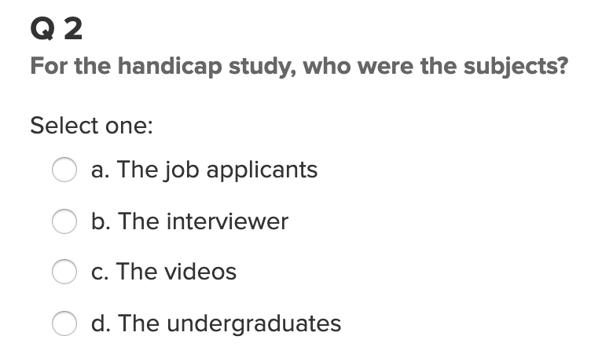
Quick Quiz Question 2 (<15 min)

Slide 23
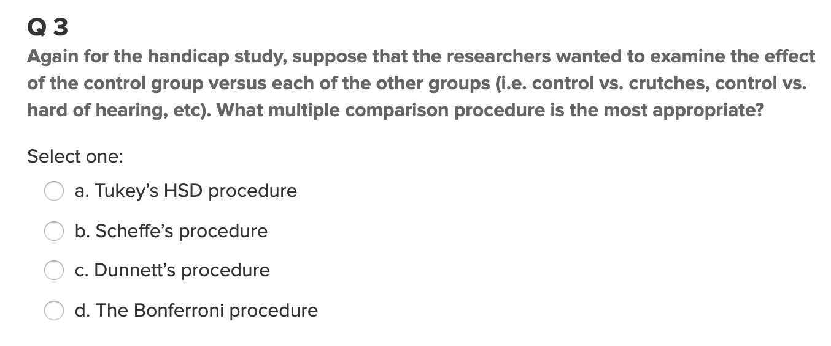
Quick Quiz Question 3 (<15 min)

Slide 24
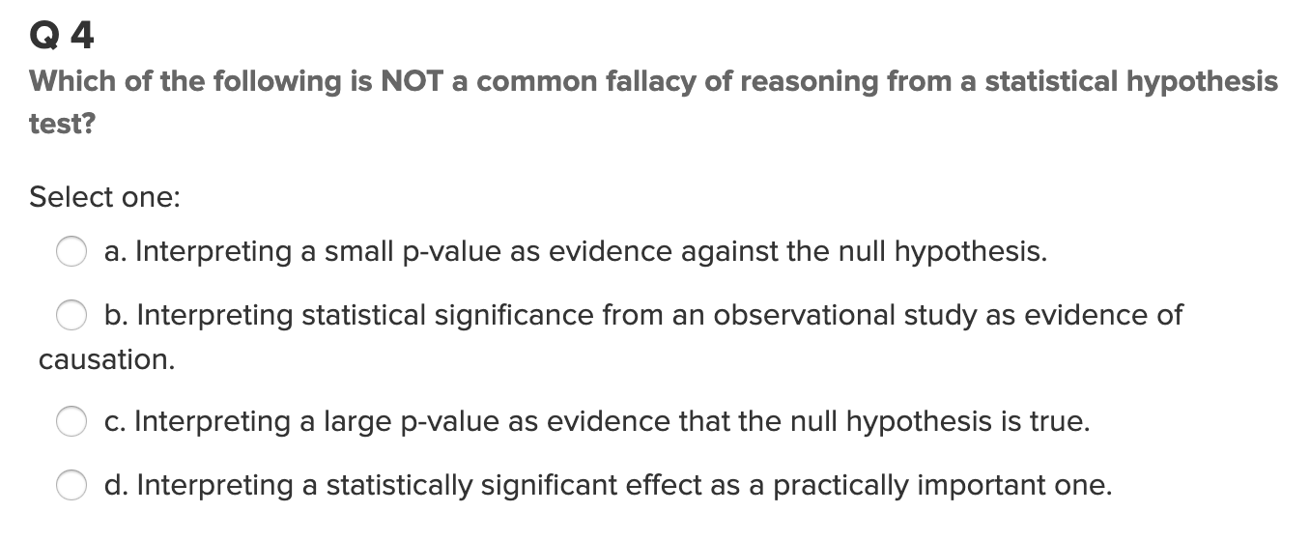
Quick Quiz Question 4 (<15 min)

Slide 25
Attempt First Two Questions from the HW this Week!
Please put your responses for each question on slides so you can easily and effectively present / share them to your peers in live session!
Be sure and also eventually put them in document form to submit them as homework.
Remember, the assignment is to attempt each problem. The correct answer is not required to get full credit, but a full attempt is. If you exhaust the minimum amount of time required to attempt the problem without a solution, there must have been some issues that popped up. In this case, fully describe what these issues were, how they were addressed, what was learned in addressing them. Basically, whether you arrived at a complete answer or not, use the slides to explain the path that you explored in that time. I can’t tell how much this will help everyone in live session.

Slide 26
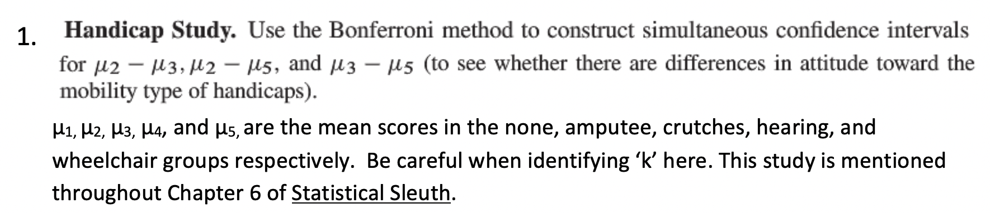
Question 1 (< 2 hours)

Slide 27
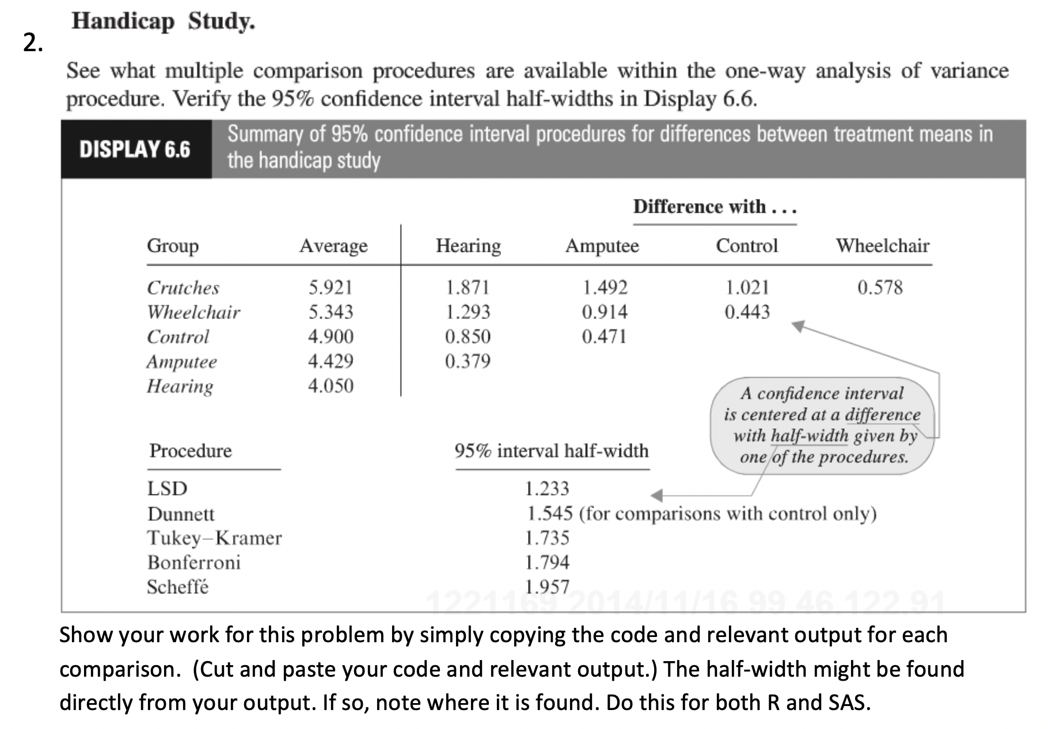
Question 2 (< 2 hours)

